Slide 1
REVSHOP
E-Commerce Application

Slide 2
REVSHOP – E-Commerce Web Application
Full Stack Development Project
Team Lead: Ajay Kumar
Team Members:
Mounika
Keerthan
Bharath Kumar
Amit Patel
Tech Stack: Spring Boot | Angular | MySQL | JWT

Slide 3
Project Overview
What is RevShop?
RevShop is a full-stack monolithic e-commerce web application for:
Buyers – Browse, Cart, Order, Review
Sellers – Manage inventory, Orders, Stock alerts
Role-based authentication
Secure simulated payment system
Responsive UI using Bootstrap

Slide 4
Functional Requirements
Core Features Implemented
User Registration & Authentication
Secure Login using JWT
Complete CRUD operations
Search & Filter products
Role-based features (Buyer/Seller)
Input validation (Backend + Frontend)
All required use cases implemented

Slide 5
Backend Implementation
Architecture
Three-Layer Architecture
Controller Layer
Service Layer
Repository Layer
RESTful APIs implemented
Proper Separation of Concerns

Slide 6
Backend Security
Security Implementation
JWT Authentication
Spring Security integration
Password Encryption using BCrypt
Role-based Authorization
Input Validation & Sanitization

Slide 7
Database Design
Database Implementation
ERD Designed
Entities (User, Product , Favorites , Categories ,Order, Cart, Review, Notification)
JPA & Hibernate ORM
MySQL Database
Transaction Management using @Transactional

Slide 8
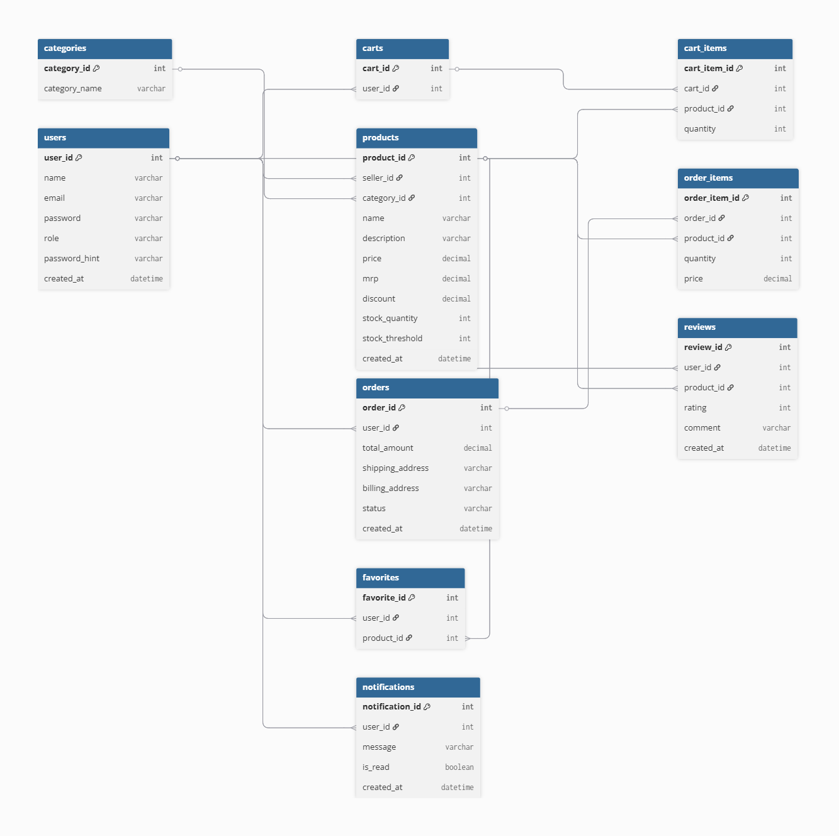
ER Diagram

Slide 9
Team Work Distribution
Ajay Kumar (Team Lead)
Project Architecture Design
Authentication & JWT
Security Configuration
ER Diagram
Order Module
Cart Module
Home & Shop UI
API Integration

Slide 10
Bharath Kumar
Product Management Module
Seller Inventory
Discount Feature
Keerthan
Review & Rating System
Favorites Module
Favorites and review Components in frontend
Mounika
Notification System
Category
Notification Components in frontend
Amit Patel
Payment Simulation
Order Confirmation
UI Enhancements

Slide 11
USER ROLES IN REVSHOP
Buyer
Browse products
Add products to cart
Place orders
Give reviews and ratings
Seller
Add, update, delete products
Manage stock
View orders and reviews

Slide 12
BUYER FEATURES
User registration and login
Browse products by category
Search products using keyword
Add, remove, update cart items
Checkout with simulated payment
View order history
Add reviews and favorites

Slide 13
SELLER FEATURES
Register and login as seller
Add new products
Update and delete existing products
Set inventory threshold
View orders for their products
View reviews and ratings
Receive low stock alerts

Slide 14
CART MANAGEMENT
Cart Functionalities
Add products to cart
Update product quantity
Remove products from cart
View cart details
Cart cleared after successful checkout
Benefits
Improves shopping experience
Prevents order mistakes

Slide 15
ORDER MANAGEMENT
Order Process
Buyer adds products to cart
Buyer enters shipping and billing details
Payment is simulated
Order is placed
Order details stored in database
Order History

Slide 16
PAYMENT SIMULATION
Why Simulated Payment?
No real payment gateway required
Suitable for console application
Payment Features
User selects payment method
Payment success or failure is simulated
Order placed only on successful payment

Slide 17
INVENTORY, REVIEWS & ORDERS
Stock quantity maintained for each product
Seller sets stock threshold
Stock reduces automatically after order
Buyers can give ratings (1–5) and comments
Sellers can view reviews for their products

Slide 18
NOTIFICATIONS SYSTEM
Buyer notified when order is placed
Seller notified when new order is received
Seller gets low stock alerts
Improves communication
Provides real-time updates

Slide 19
SECURITY & VALIDATION
Login using email and password
Change password after login
Forgot password using security question and answer
Input validation at service layer
Secure user access
Exception Handling

Slide 20
TESTING & LOGGING
JUnit 5 used for testing
Password, product, and cart validations tested
Log4j used for logging
Logs login, orders, and errors
Helps in debugging and reliability

Slide 21
Challenges Faced
403 Forbidden errors (Spring Security configuration)
JWT filter integration issues
Angular route guard injection errors
How We Solved:
Debugging security configuration
Proper filter chain setup
Correct Angular dependency injection

Slide 22
Future Enhancements
Payment Gateway Integration – Add real-time online payments
Email Notifications – Send updates to users via email
Order Cancellation- Users can cancel the orders
Order Tracking- Users can track the orders
Wallet System-Users can maintain a wallet in this website.
We migrate our project to Micro Services in future.

Slide 23
Conclusion
RevShop is a secure and scalable e-commerce platform built using modern full-stack technologies.
As a Team we have
Designed architecture
Implemented authentication
Managed team module division
Integrated frontend & backend
This project enhanced our: Full Stack Skills Team Coordination Debugging Skills

